Slide 1

WELCOME TO OUR PRESENTATION
➔Presentation On Our Game Project “POS(parts of speech) Guide”

Slide 2
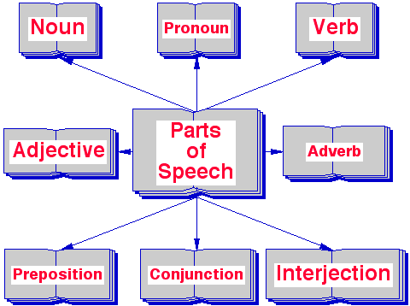
About Parts Of Speech

Slide 3
Project Name
POS(PARTS OF SPEECH)GUIDE

Slide 4
Objective
Have fun playing our grammar games. Practice your English with word order games, parts of speech games and learn English as you race to choose parts of speech from given words. Enjoy these fun grammar games for kids. Find a range of free interactive exercises and practice activities that are perfect for helping students learn English. Learn about parts of speech with this fun game for kids. This games practice activity for students involves a series of challenges related to parts of speech. Find these types of words in sentences and understand when to use them properly. Press numbers for correct answer. Complete as many challenges as you can and have fun learning English!

Slide 5

Features
Improve English grammar skill.
Children can learning by playing this game.
Multiplayer is enable for this game.

Slide 6
Tools
C++ language.
CodeBlocks.

Slide 7
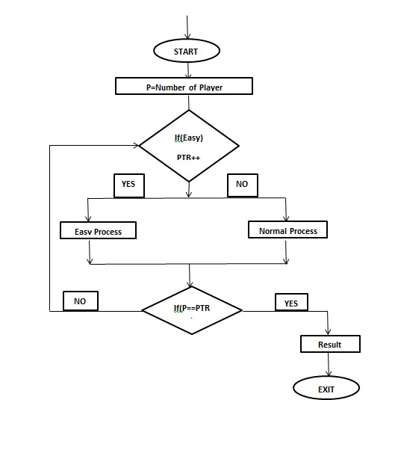
Project Diagram/FlowChart

Slide 8
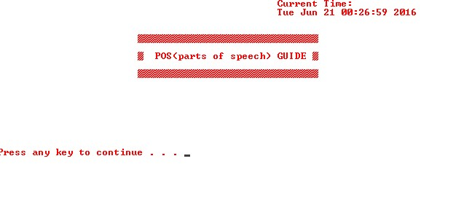
INTERFACE OF “POS GUIDE”
Frist Page

Slide 9
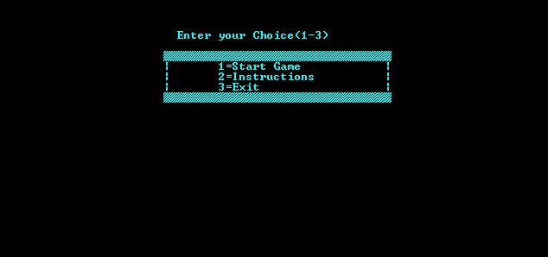
Second Page

Slide 10

Third Page

Slide 11
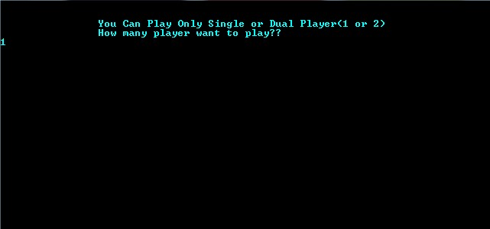
Fourth Page(if you play with single player)

Slide 12

Fifth Page(if you play with single player)

Slide 13

Sixth Page(if you play with single player)
If Press (1 or 2) Then The Question Set Will Be Shown

Slide 14

Seventh Page(if you play with single player)

Slide 15
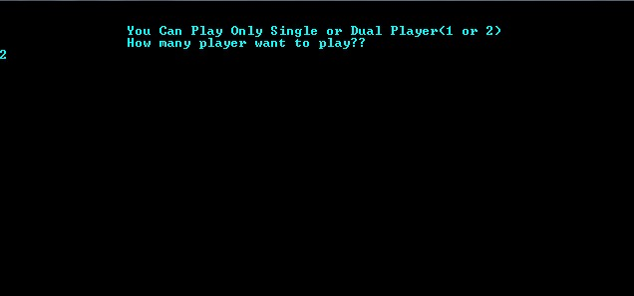
Fourth Page(if you play with Dual player)

Slide 16

Fifth Page(if you play with Dual player)

Slide 17

Sixth Page(if you play with Dual player)
If Press (1 or 2) Then The Question Set Will Be Shown

Slide 18

Seventh Page(if you play with Dual player)
If Press (1 or 2) Then The Question Set Will Be Shown

Slide 19

Eighth Page(if you play with Dual player)

Slide 20

Ninenth Page(for Single or Dual player)

Slide 21
Limitations
Question set is limited.
User interface is no efficient.
Not more than two players can play at a time.

Slide 22
Conclusion / Summary
Hence after the completion of the project we got familiar with the C programming and C++ programming and their features. A dual mode (single player and multiplayer) console game can only be developed with lot of intensive effort and time. Due to lack of time and we are beginners in programming, program that we expected can’t be developed by us. Our console game may not be perfect but it will be useful for playing Parts Of Speech and programming practice using C and C++ language. As a whole, the project has been a good learning experience for us. We have gained knowledge about the various aspects of C and C++ programming. At the same time, we have developed a deep understanding about the application developing interface. We still want to emphasize that the program is not complete by itself. There is still a lot of room for improvement. Graphics may be added to program to make it more attractive.

Slide 23
PLAY THIS GAME
WE THINK YOU CAN ENJOY AND LEARN SOMETHING FROM THIS GAME
Thank You!!

